Slide 1
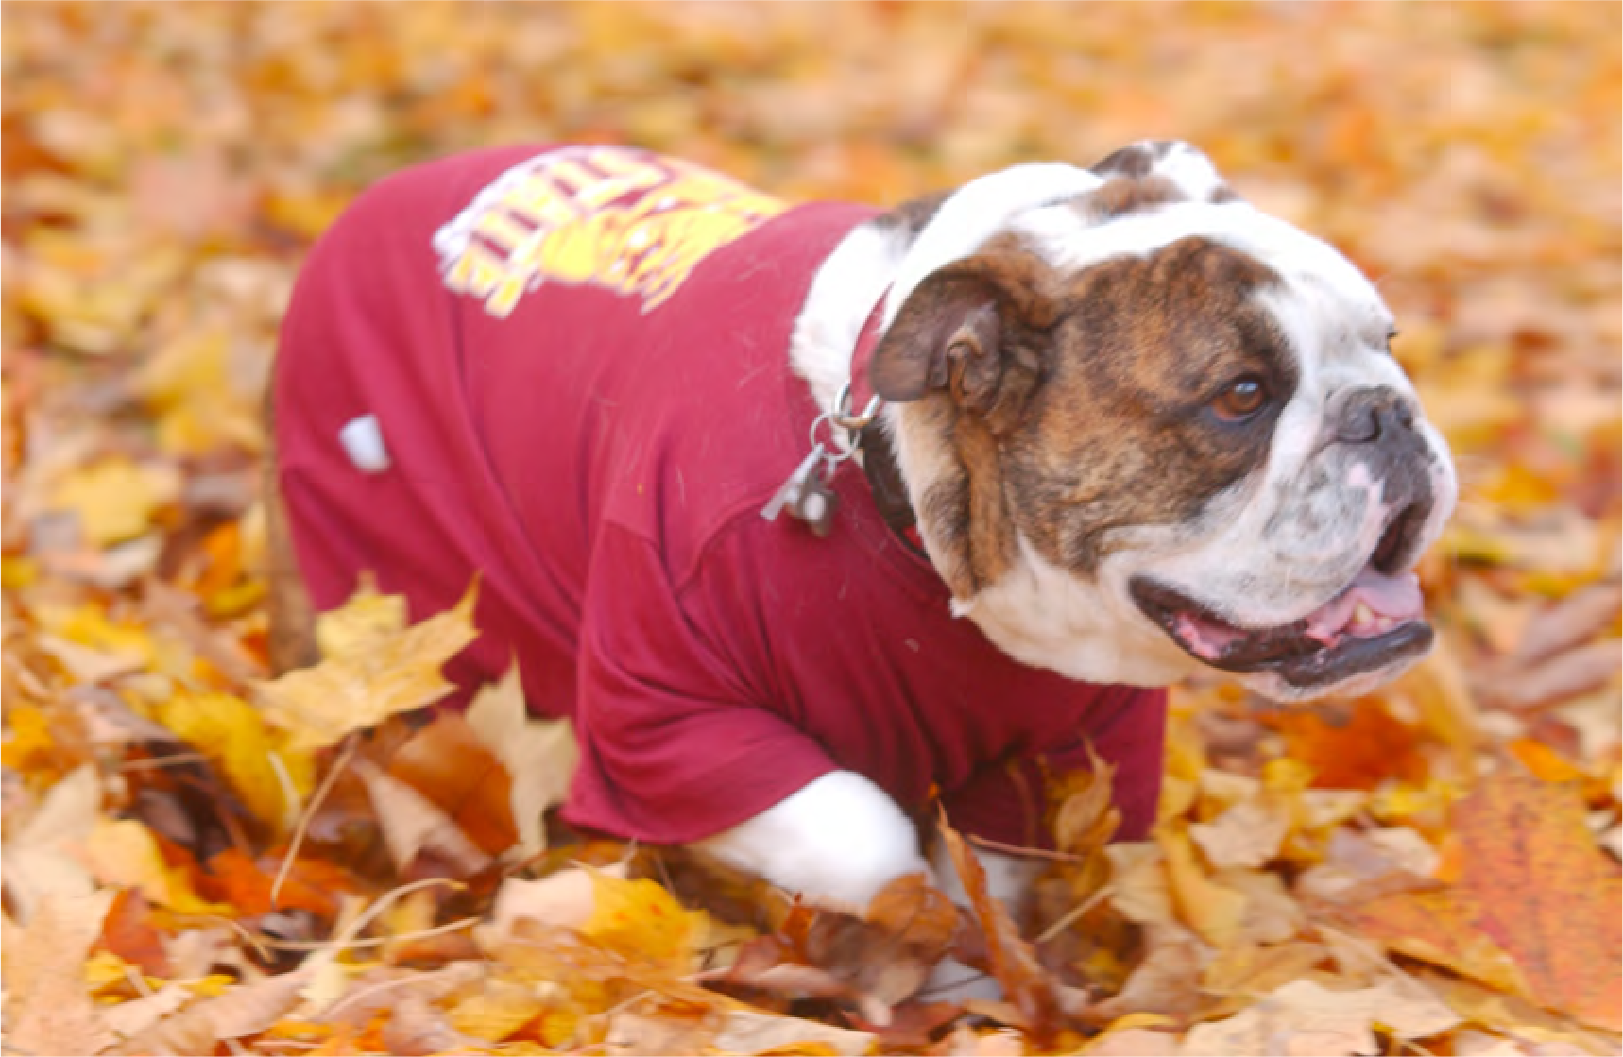
The Internet of Things (IoT): How to Engage All Students in Computational Thinking
Katie Kalata, Ph.D.
KathleenKalata@ferris.edu
Assistant Professor
Computer Information Technology
Computer Information Systems
Ferris State University
Big Rapids, Michigan
www.raspberrypi.cloud
MACUL, Grand Rapids, MI, March 17, 2022
1

Slide 2
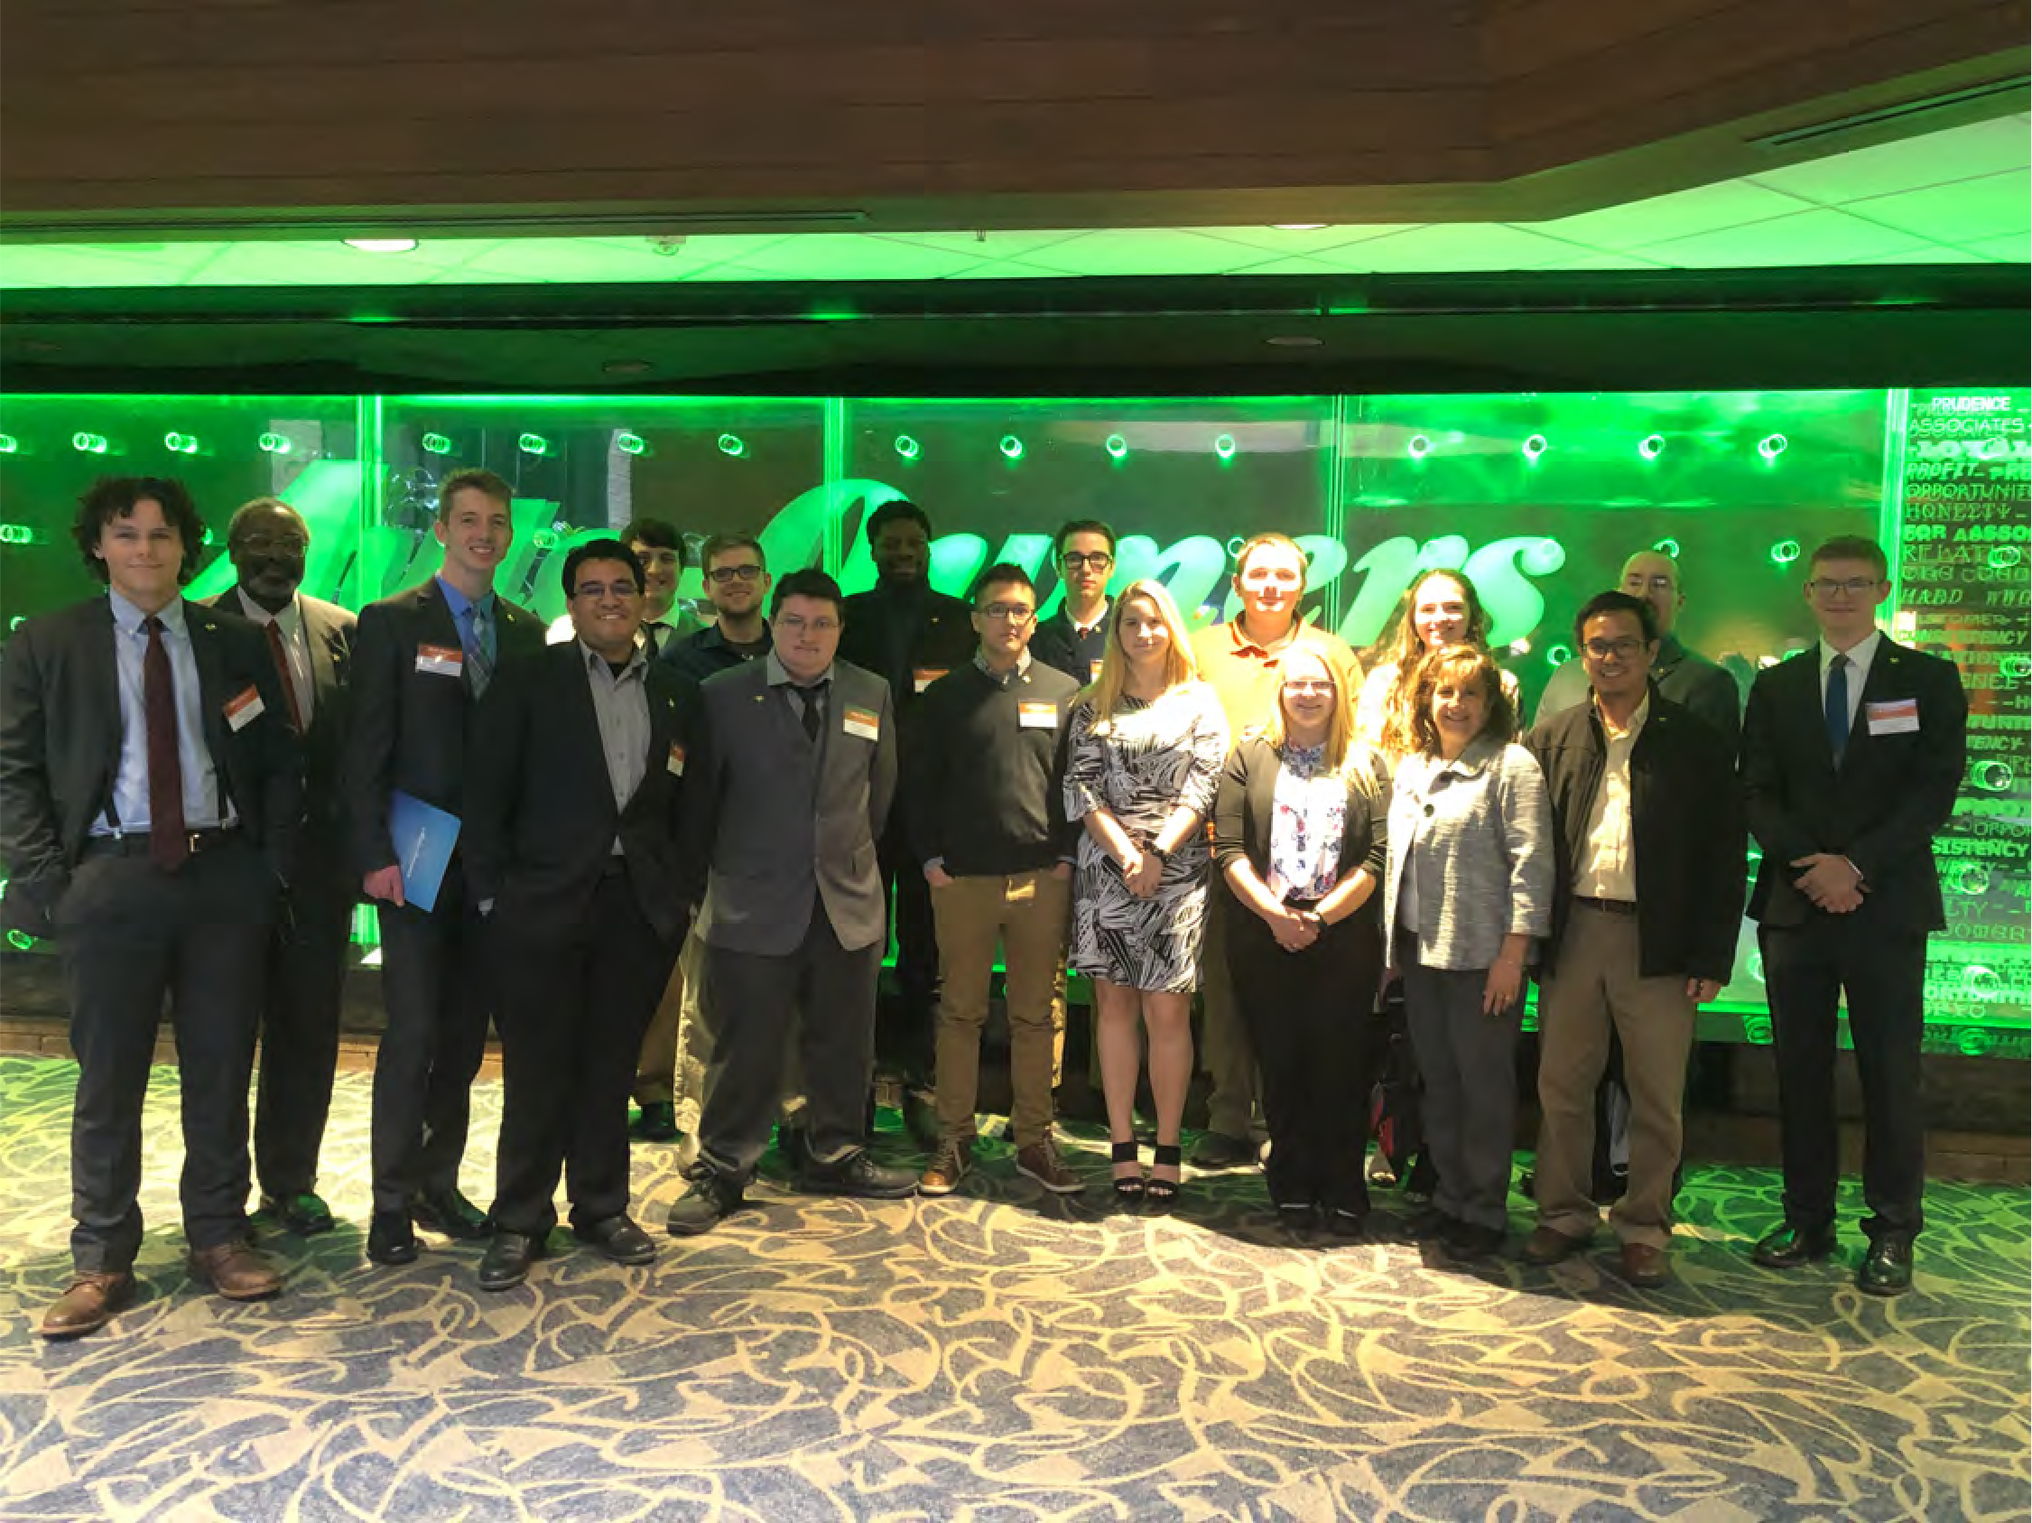
Our Motivation
Empower Our Students
2

Slide 3
Program Description
~ 50 billion IoT-enabled devices will be in the world by 2030!
Video doorbells, home energy control and biometrics are part of the Internet of Things (IoT).
Designed for “IoT Beginners”!
Learn how to bring IoT projects into science, health, the arts, math, history, and other subjects!
Engage students in a problem-solving process where they can leverage the IoT to identify problems, collect and analyze data, design, develop and test solutions.
IoT devices help us solve problems.
MITECS is about problem solving!
Computational thinking (CT) and computer science (CS) is all about solving problems!
Housekeeping!
Notes:
Camera Picture – Question mark

Slide 4
Learning Objectives
Discuss the differences between computer science, programming, and computational thinking, and why computational thinking defined in MITECS should be used throughout the entire K-12 curriculum.
Compare the difference between the World Wide Web, Robotics and the Internet of Things (IoT) by demonstrating examples of IoT and list resources required for implementation of the IoT projects.
Describe pedagogical methods to promote engagement and empower students, as students work in groups, implement computational thinking and integrate IoT technologies to solve real-world problems.

Slide 5
Session Outline ↬ The Plan!
Computational Thinking & MITECS
Programming vs Software Developers
Integrating Computational Thinking throughout the K-12 curriculum
A Beginners Guide
to the Internet of Things (IoT)
Just Enough Tech: What you and your students need to know to get started.
Example IoT projects that solved real-world problems
Demonstration: IoT projects for K-12
Design group projects
POGIL – Pedagogical methods to keep students engaged & empowered
IoT resources
Q & A *
* Presentation time is limited! Additional information and resources are available at the end of the presentation slides.

Slide 6
Computational Thinking
Integrating Computational Thinking (CT) throughout the K-12 curriculum

Slide 7
Converging Standards in K-12 Education
International Standards: ISTE
ISTE=MITECS For Students:
1.1 Empowered Learner
1.2 Digital Citizen
1.3 Knowledge Constructor
1.4 Innovative Designer
1.5 Computational Thinker
1.6 Creative Communicator
1.7 Global Collaborator
State Level Standards: MITECS
Computational Thinking ≠ Programming!
MITECS – December 2017
ISTE – International Society for Technology in Education – Adopted in all states

Slide 8
ISTE ↬ What is a Computational Thinker?
Students develop and employ strategies for understanding & solving problems in ways that leverage the power of technological methods to develop & test solutions.
Students formulate problem definitions suited for technology-assisted methods such as data analysis, abstract models and algorithmic thinking in exploring and finding solutions.
Students break problems into component parts, extract key information, and develop descriptive models to understand complex systems or facilitate problem-solving.
Students collect data or identify relevant data sets, use digital tools to analyze them, and represent data in various ways to facilitate problem-solving and decision-making.
Students understand how automation works and use algorithmic thinking to develop a sequence of steps to create and test automated solutions
ISTE – 1.5 Computational Thinking

Slide 9
MITECS - Computational Thinking
Michigan Integrated TEchnology Competencies for
Students
MITECS – December 2017

Slide 10
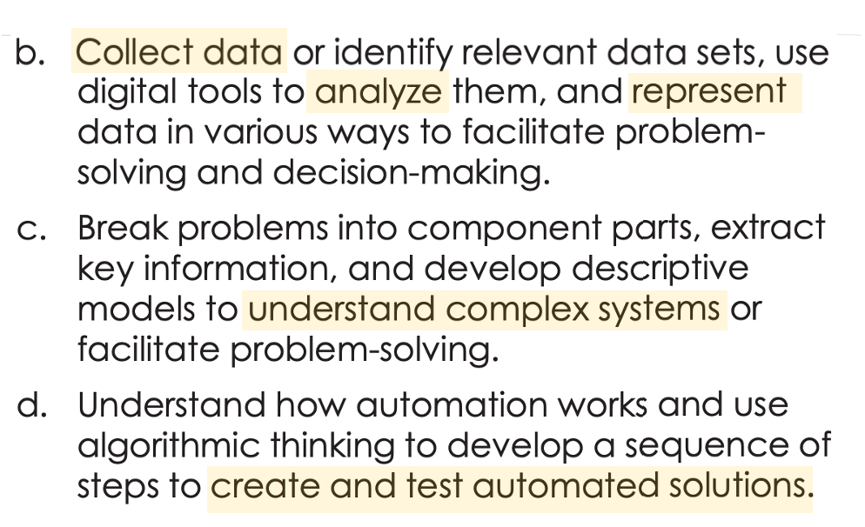
What is Computational Thinking
in MITECS?

Slide 11
What’s the Difference?
CS Concepts (CSTA)
communication & coordination
human-computer interaction
algorithms & programming
networks & the internet
impacts of computing
system relationships
computing systems
privacy & security
data & analysis
abstraction
Computational Thinking (ISTE-MITECS)
A problem-solving process that includes, but is not limited to, the following characteristics: formulating problems in a way that enables us to use a computer and other tools to help solve them; logically organizing and analyzing data; representing data through abstractions such as models and simulations; automating solutions through algorithmic thinking (a series of ordered steps); identifying, analyzing and implementing possible solutions with the goal of achieving the most efficient and effective combination of steps and resources; and generalizing and transferring this problem-solving process to a wide variety of problems.
Codio - CSTA
K12 CS Framework and the CSTA K12 CS Standards by Grade Level
Web/Mobile are lost in cyberspace!
ISTE - Computational Thinking

Slide 12
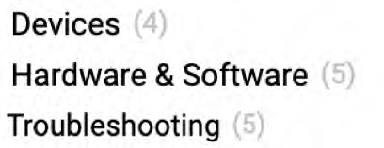
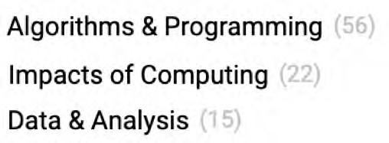
CSTA Standards and Concepts
CSTA – 120 Standards
Concepts
Subconcepts
CSTA 120 Standards
Computer Science Teachers Association (2017). CSTA K-12 Computer Science Standards, Revised 2017.

Slide 13
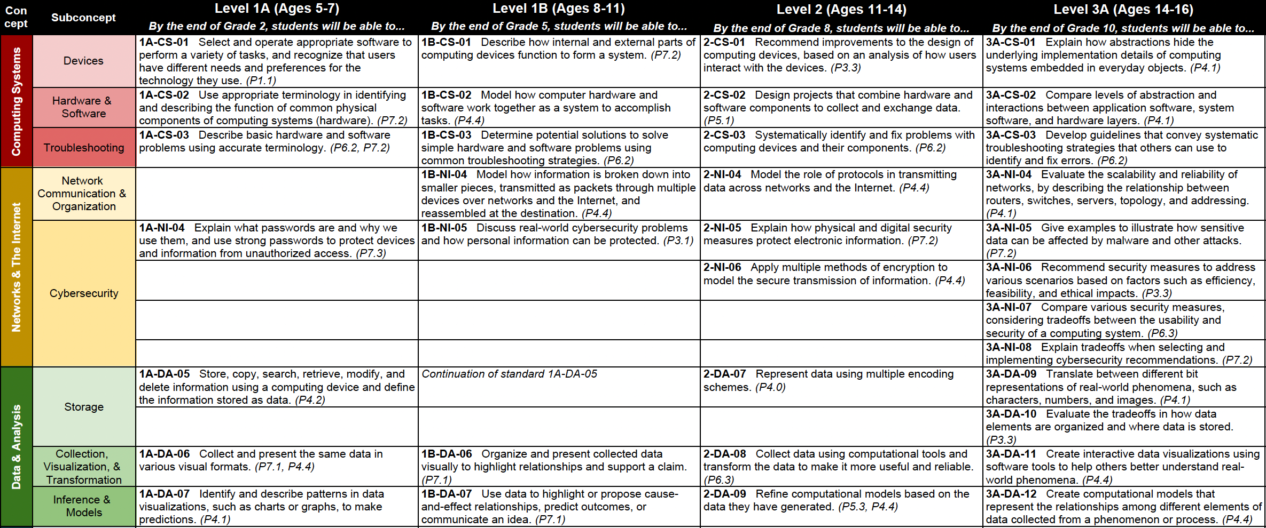
Progression Chart for Computing and Networking
CSTA Standards - Progression Chart

Slide 14
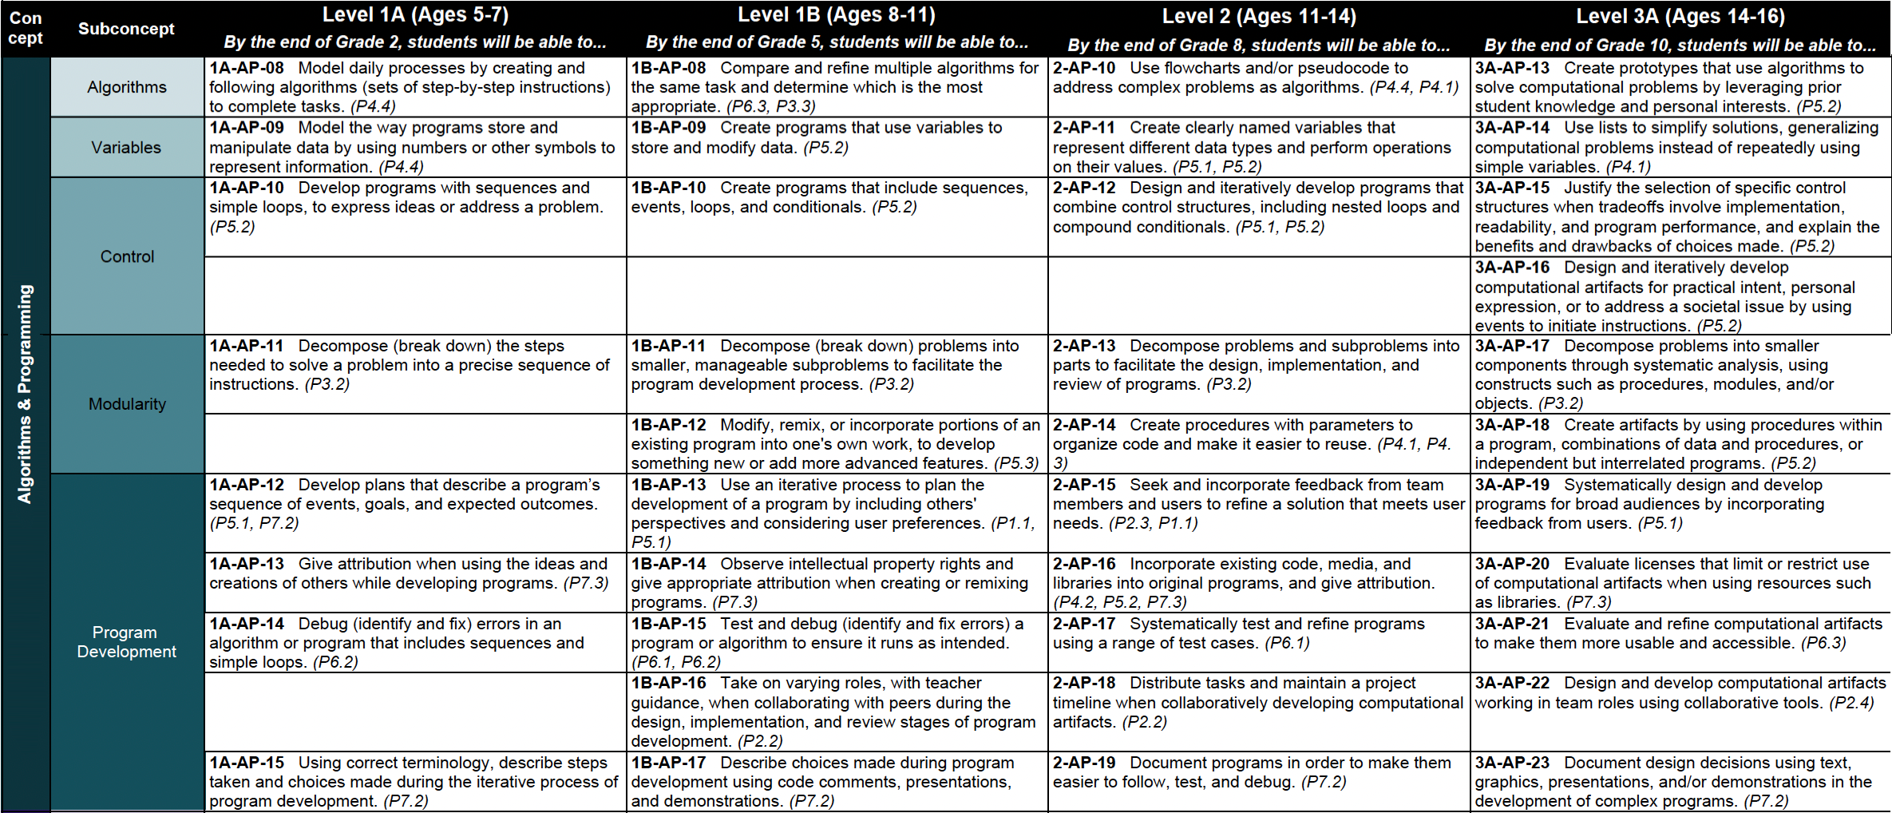
Progression Chart for Computing and Networking
CSTA Standards - Progression Chart

Slide 15
What’s the Difference SD vs CP?
Software Developers (SD)
Design computer applications or programs.
Analyze users’ needs, design, develop software
Recommend software upgrades
Design each piece of an application or system & plan how the pieces will work together
Create a variety of models & diagrams showing programmers software code needed
Ensure a program continues to function normally through software maintenance & testing
Document an application or system as a reference for future maintenance & upgrades
Computer Programmers (CP)
Write & test code that allows computer applications & software programs to function properly.
Write programs in a variety of computer languages: C++ & Java
Update & expand existing programs
Test programs for errors & fix code
Create & test code
Use code libraries, collections of independent lines of code
US BLS – Software Developers versus Programmers
US BLS – Computer & Information Technology

Slide 16
Why Teach IoT in K-12 ?
Connecting the Disciplinary Dots . . . . . . . . . . . . .
IoT is a set of cross-curricular skill & technologies.
You don’t need a PhD to learn about IoT, how to use IoT or incorporate IoT into the classroom!
Technologies
Single board computers (Pi)
Microcomputer (Arduino)
Computing sciences
Information systems
Software & Programming
Networking
Electronics & Hardware
Embedded systems
Systems thinking
Data management & analytics
Courses:
Health sciences
Physical sciences
Biological sciences
Mathematics
Physics & Chemistry
Project management
Business skills

Slide 17
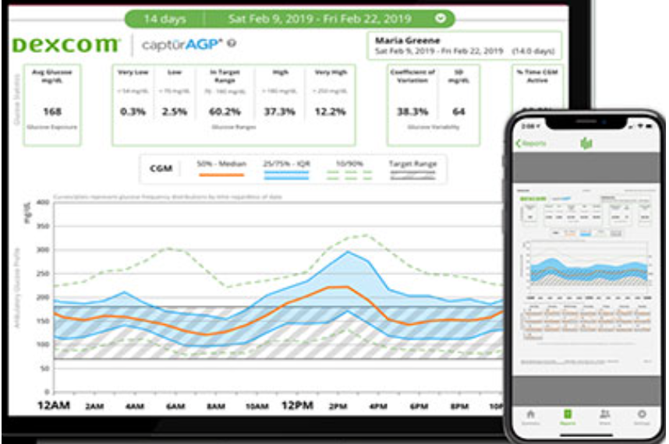
Wearable & Portable Monitoring – The Why!
Dexcom & Tandem
BG Monitoring, Pump & Apps
From: Maximintegrated, “Wearable & Portable Monitoring” (From the Pulse Oximeter)

Slide 18
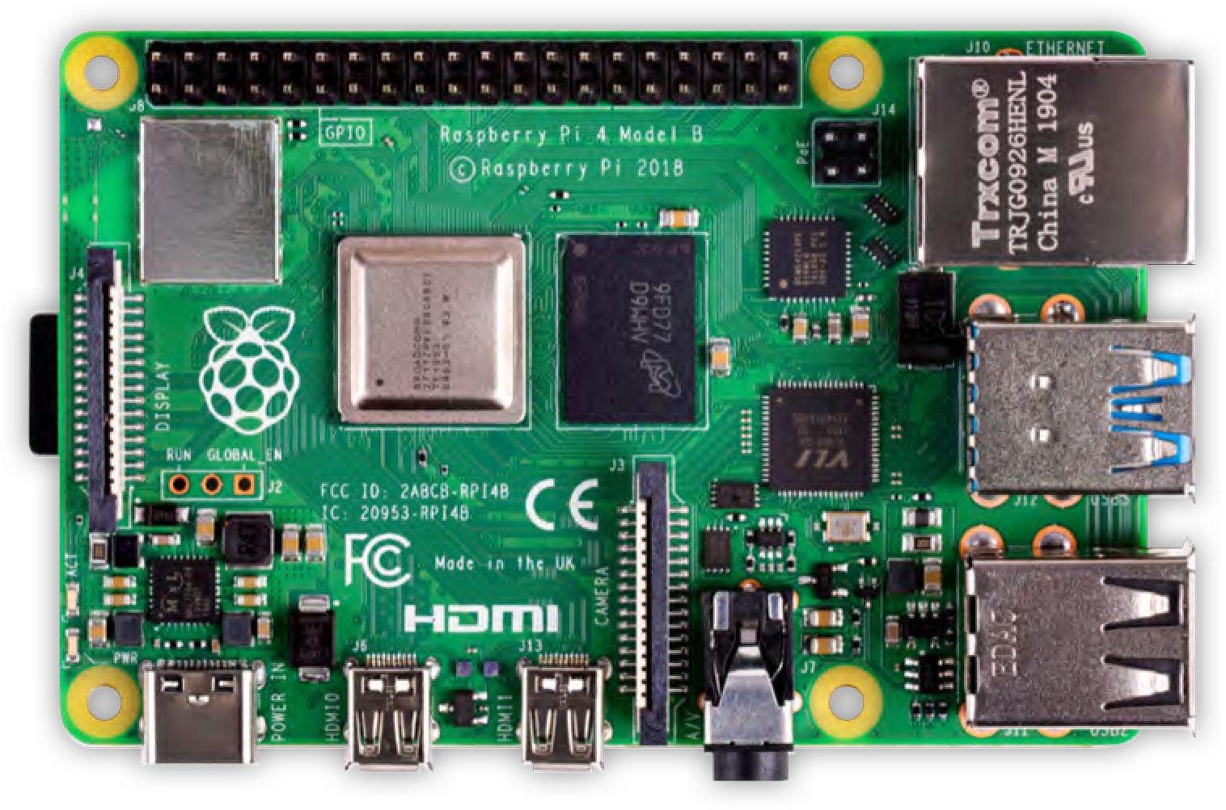
A Beginners Guide to the Internet of Things (IoT)
Just Enough Tech:
What you and your students
need to know to get started!

Slide 19
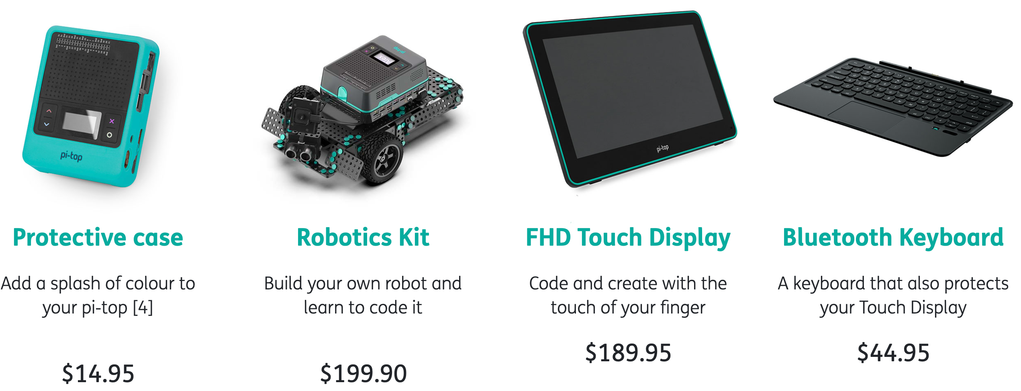
Younger Grades
Pi-Top
5 hour battery
Easy to put together
Multiple Uses
Easy to use!
Electronics Kit available!
Costly!
Pi-Top = $99.95
Electronics Kit = $79.95
From: Pi-Top Web Site

Slide 20
Pi-Top Electronics Kit
You MUST use their power adapter – sold separately!
1x Foundation Plate – Digital & Analog ports. Can also access GPIO & add ‘tops’ to the Pi.
1x Ultrasonic Sensor
1x Buzzer
1x Light Sensor
1x Sound Sensor
2x Potentiometers a type of position sensor (ie. Rotate a dial).
2x Green LEDs
2x Yellow LED
2x Red LEDs
2x Buttons
8x Connecting cables
Robot – if you also get that,
has a camera too!

Slide 21
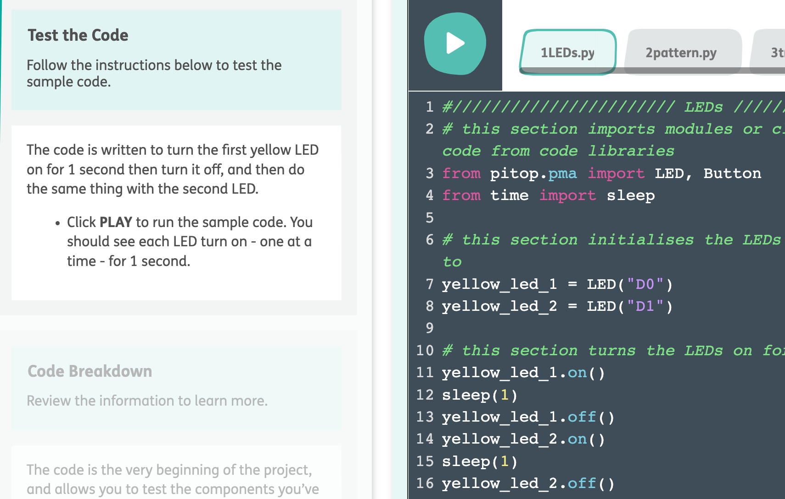
Further Coding – Challenges & Tools
Use Further, web site interface for “block coding”, similar to Blockly and other K12 coding web site!
Further Library

Slide 22
Alternatives!
Arduino & SparkFun Redboards

Slide 23
Arduino Microcontroller
A single-board microcontroller is a microcontroller built onto a single printed circuit board.
This board provides all of the circuitry necessary for a useful control task: a microprocessor, I/O circuits, a clock generator, RAM, stored program memory and any necessary support ICs.
Alternative microcontroller:
Arduino Uno
No wireless connectivity
Compact, cheap
Open source hardware
Arduino Mega, Nano (smaller)
Pounder, Les. (July 10, 2020). Raspberry Pi vs Arduino: Which Board is Best?
@ Tom’s Hardware
Bardwell, Tom. (February 1, 2022). Best Raspberry Pi Alternatives.

Slide 24
Microcontrollers
SparkFun RedBoard
Arduino-compatible
Very customizable!
Not a desktop computer!
Interface – GPIO pins, I2C, and others. Now, I2C integrated circuit making it easy to connect to other devices.
Hookup Guide
arduino.cc

Slide 25
Alternatives!
What about
Raspberry Pi’s?

Slide 26
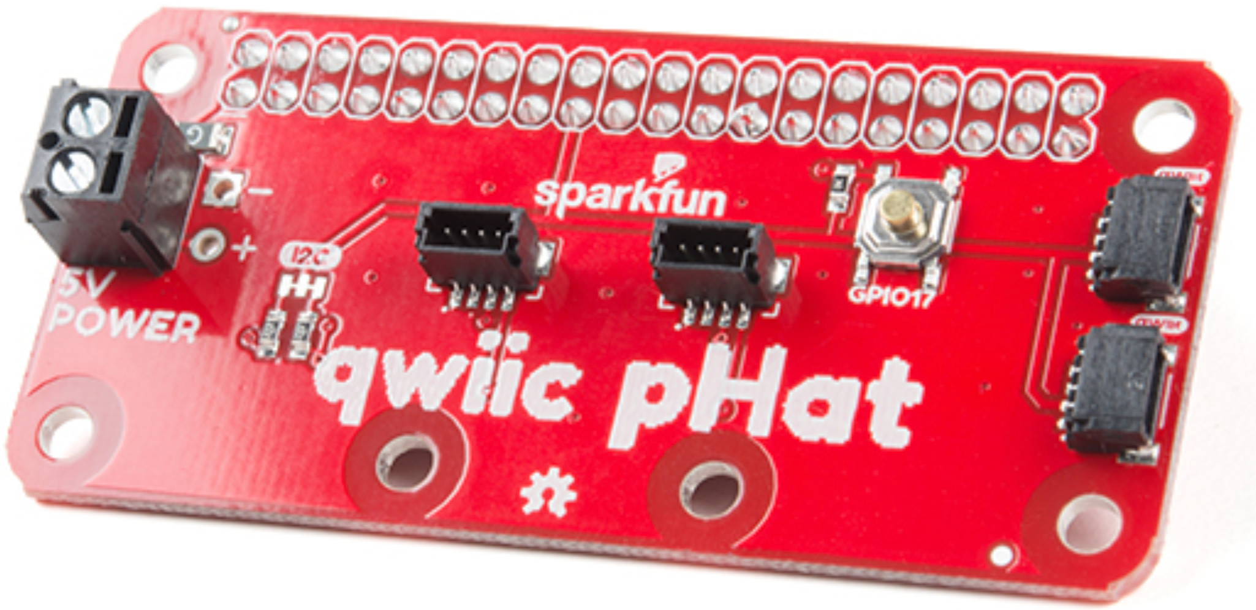
Raspberry Pi - Single Board Computers
$7.95
Raspberry Pi
Ultra-compact desktop
Single Board general purpose computer (2012 for $35-80)
Several versions today
Pi Zero W (1st $5 computer)
SparkFun Qwiic pHAT v2.0 for Pi –
Provides I2C connectivity with Qwiic Connectors, like you see in the Pi-Top
The GPIO I2C pHAT is an I2C switch which mounts under your HAT to remap its I2C pins (GPIO 2 & GPIO 3) to 1 of 4 additional I2C buses, without the need for a multiplexer or expander.
https://learn.sparkfun.com/tutorials/i2c

Slide 27
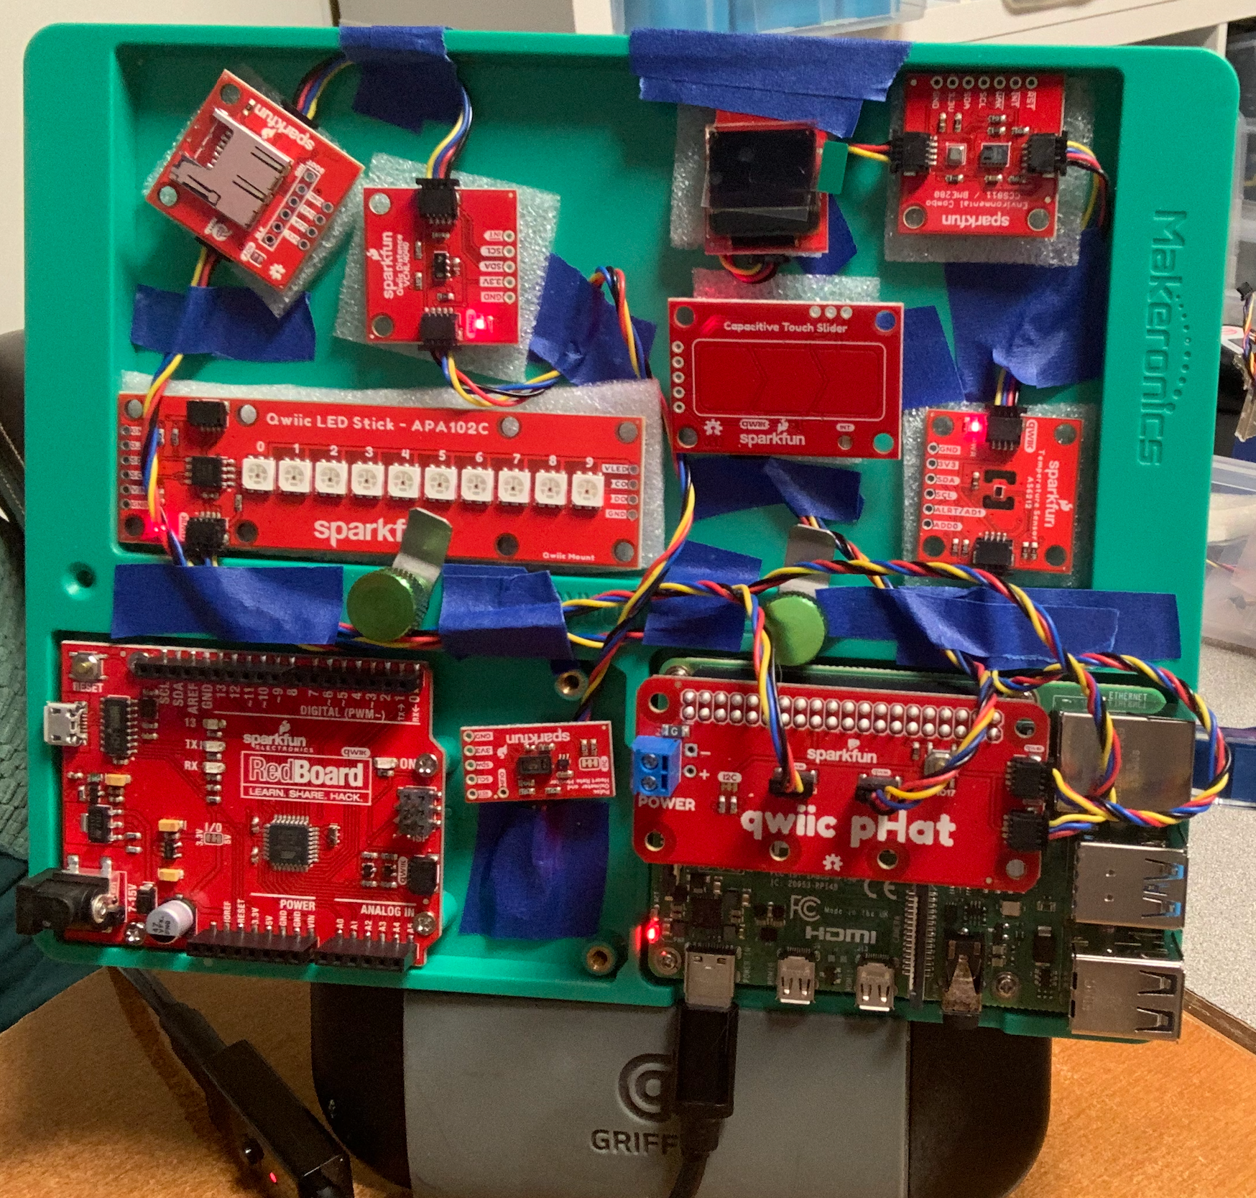
IoT
Sensors and other IoT devices.
Use 3D printers to create ‘cases’ or use traditional media, wood, paper and other items to enclose the hardware!

Slide 28
Example IoT projects that solved real-world problems
Demonstration:
IoT projects appropriate for K-12

Slide 29
Temperature AS6212
$9.95
Each sensor can be used with Arduino as well as Pi, and others! Just need to get the right cables!
Hookup Guide

Slide 30
Demo 1 – Use what you know!
Basic Python
Any Python editor: PyCharm, Thonny, Idle, Visual Code

Slide 31
Import Python Libraries for Qwiic and Each Sensor!
Import Python code libraries!
Need to install some code libraries like Qwiic, from the command line!
Use the HOOKUP GUIDES!
Qwiic_GitHub Py Library
Qwiic_GitHub I2C_Pi Library
Qwiic I2C - Read the Docs
Qwiic – Read the Docs

Slide 32
How to Take the Temperature
Hardest part – Figuring out the library & API’s!
SparkFun Documentation:
Read The Docs
GitHub for code
DEMO

Slide 33
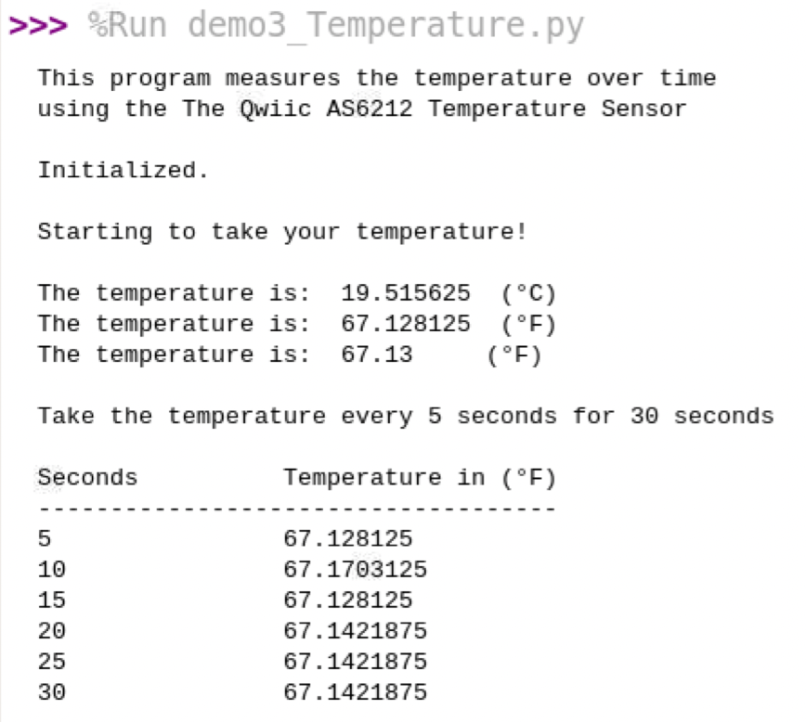
Repeat Temperature Readings
Just put it in a loop!
Sleep & wake cycles to save power
Can also use Alerts and Triggers!
DEMO

Slide 34
Environmental Combo
Indoor air quality monitoring
WHY?
DEMO
CCS811 - Air Quality = Digital gas sensor solution
CO2 (or equivalent eCO2) from 400 to 8,192 parts per million (PPM)
Total Volatile Organic Compound (TVOC) 0 to 1,187 PPBillion and and metal oxide (MOX) levels.
Fine-tune readings with current humidity and temperature.
BME280 – Environmental
Temp Range: -40C to 85C
Humidity Range: 0--100% RH, =-3% from 20--80%
Barometric Pressure Range: 30,000Pa to 110,000Pa, relative accuracy of 12Pa, absolute accuracy of 100Pa
Altitude Range: 0 to 30,000 feet (9.2 km), relative accuracy of 3.3 feet (1m) at sea level, 6.6 (2m) at 30,000 feet
$38.50
Requires I2C clock stretching. Easy to edit the /boot/config.txt
BME280
GitHub Qwiic Py - Library
Hookup Guide
Read The Docs
CCS811
BME280
CCS811

Slide 35
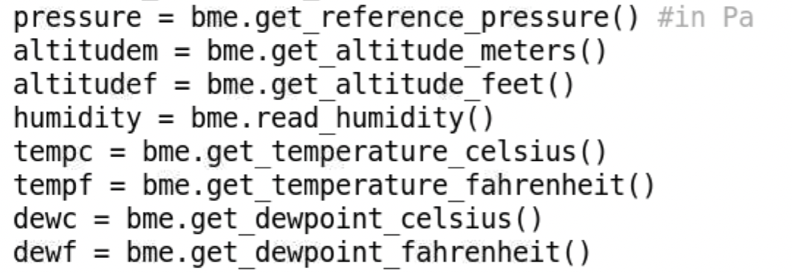
Environmental Combo
DEMO
You can see that these properties are retrievable with basic programming,
The hard part was to get the objects and use Tab key to find out about the syntax for the methods.
https://learn.sparkfun.com

Slide 36
Weather BME 280
Where to use? K-12? Science?
DEMO

Slide 37
Qwiic Kit – Chain sensors on a single bus!
“Chain” I2C sensors on a single bus (about 7)
Watch power issues!
Phat qwiic connectors provide 4 buses!
Watch as each sensor/device has a different address!
Hookup Guide
Provides Phat, 2 sensors and OLE Display - $58.95

Slide 38
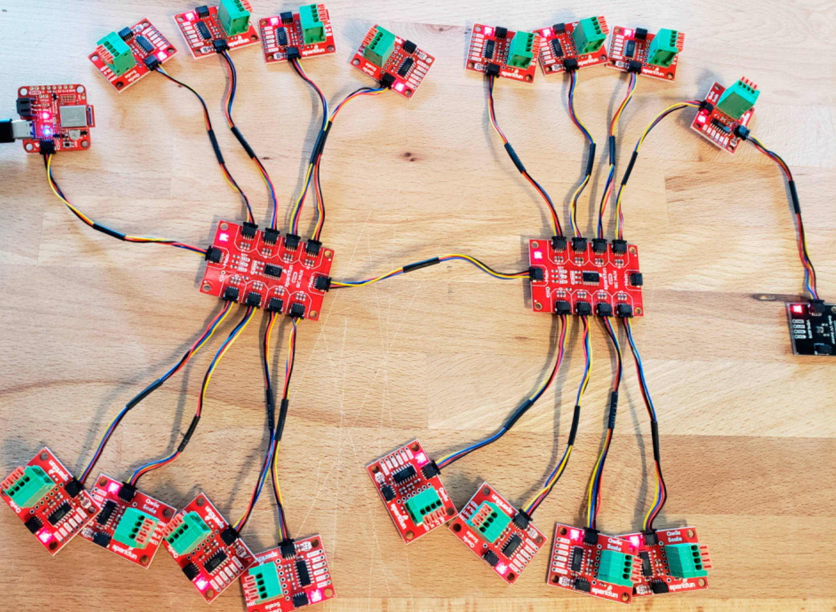
Mux Breakout
Will treat each sensor with it’s own address, so you can chain multiple sensors with the same address on the same bus!
$12.95
https://learn.sparkfun.com

Slide 39
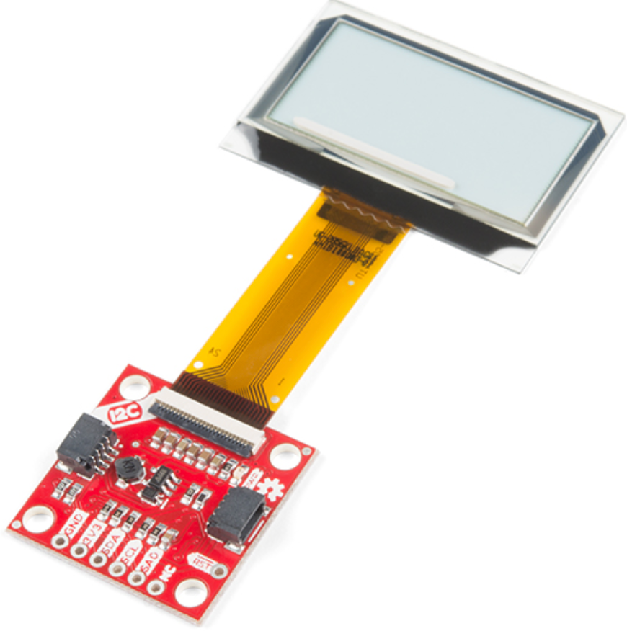
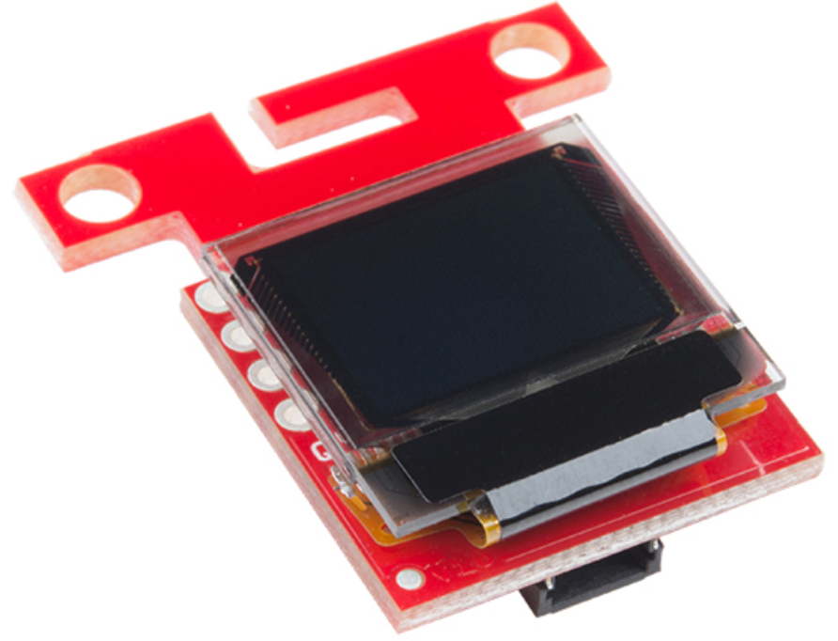
OLED Digital Displays
Micro OLED Breakout (Qwiic)
64 pixels wide and 48 pixels
4 font sizes – Blue monochrome
Can ‘draw’ with geometry!
Easy to use code!
Transparent Graphical OLED Breakout (Qwiic)
Very cool
Like a window!
DEMO
$18.50
$42.95
https://learn.sparkfun.com

Slide 40
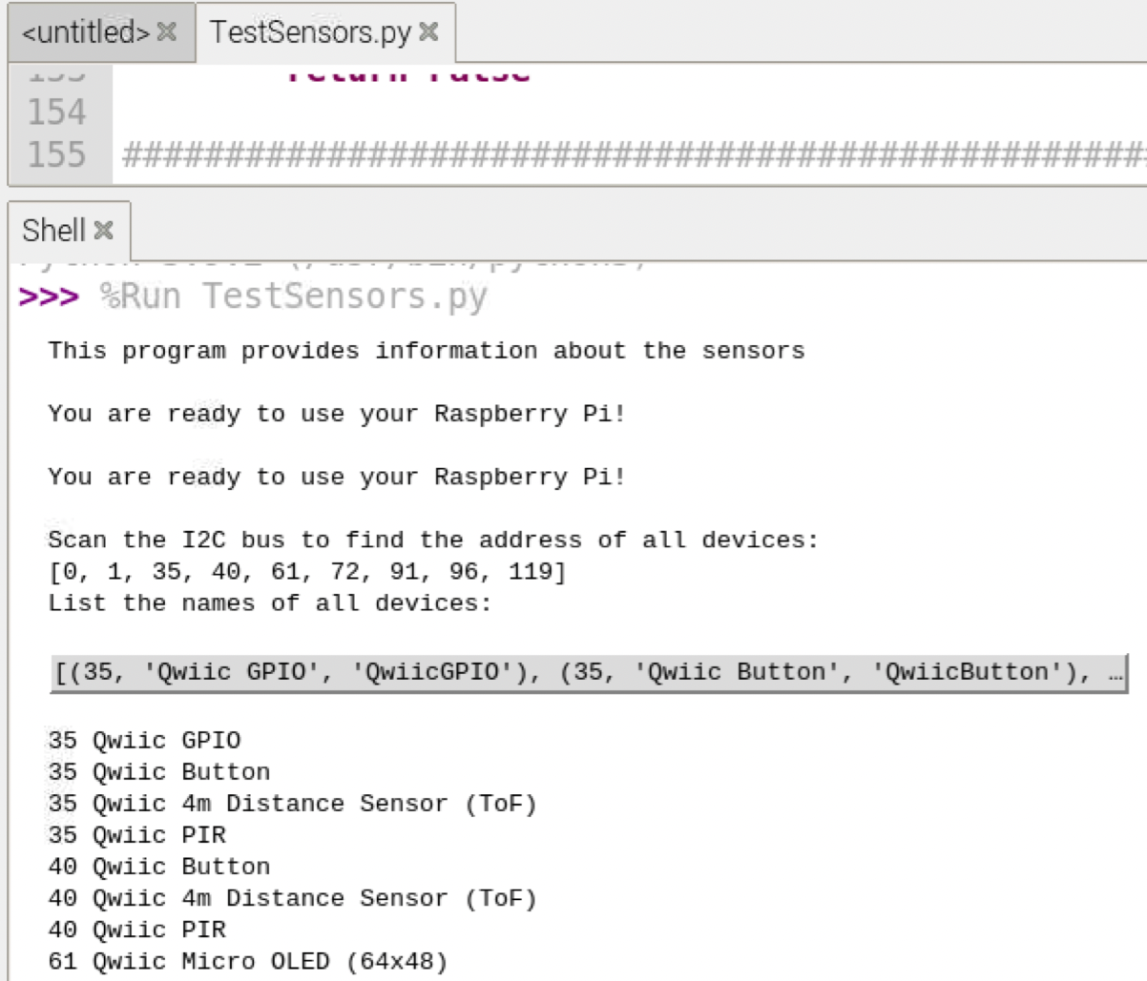
LED Stick APA 102C
Qwiic_Micro_OLED_Py
Can easily ‘find’ the I2C addresses using the Qwiic libraries
$10.95
Read the Docs
Qwiic LED Stick Python Package

Slide 41
Pulse Oximeter and Heart Rate Sensor - MAX30101 & MAX32664
$42.95
MAX30101 is the Optical Sensor.
MAX32664 analyzes the data using algorithms to determine heart rate and blood oxygen saturation (SpO2).
SpO2 = percentage of hemoglobin saturated with O2. Includes sensor's confidence level. Over 90% consistent with compared to commercial products
Python Library
Pimoroni has the python library for MAX30101 - same sensor with a different name.
GitHub pimoroni max30105-python
Hookup Guide
Maxim User Guide
Photodetector (MAX30101) Hookup Guide

Slide 42
Why when you can buy a Pulse Oximeter?
A healthcare IoT prototype for responsive oxygen therapy treatment of COPD patients
More than 1.5 million adults in the United States use supplemental oxygen f Khan_Thesis Economical and Wearable Pulse Oximeter using IoT, 2021, found 90% accuracy when result are compare with commercial health band
Pulse Oximeter Wireless Data Logger Created by John Park
Heart rate (HR) sensors Photoplethysmography, because that's a real word Martin Fitzpatrick 23 January 2021
Building a MicroPython heart rate monitor Finding the beat in HR sensor data Martin Fitzpatrick 21 January 2021

Slide 43
Capacitive Touch Slider (CAP1203)
$6.50
3 different buttons!
Enable a touch input to act as a power button
Customize sensitivity for your own touch pads
Hookup Guide

Slide 44
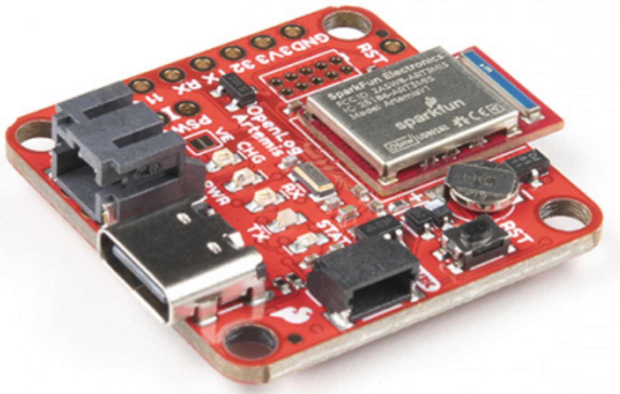
Open Log
$18.50
64MB to 32GB microSD cards
FAT16 and FAT32 formats.
Can chain with Mux
20,000 bytes per second at 400kHz.
Alternative:
OpenLog Artemis – 500,000bps
$53.50
https://learn.sparkfun.com

Slide 45
POGIL How to design group projects to keep students engaged and empowered
Why POGIL?

Slide 46
POGIL - Process Oriented Guided Inquiry Learning
POGIL is a student-centered, group-learning instructional strategy & philosophy
Small, self-managed teams
Instructor is a facilitator of learning, not the source of information.
Focus is on process skills and application of knowledge to new contexts
Students utilize 7 process skills:
Teamwork
Oral and Written Communication
Problem Solving
Critical Thinking
Management
Information Processing
Assessment (Self-Assessment & Metacognition)
https://pogil.org/about-pogil/what-is-pogil

Slide 47
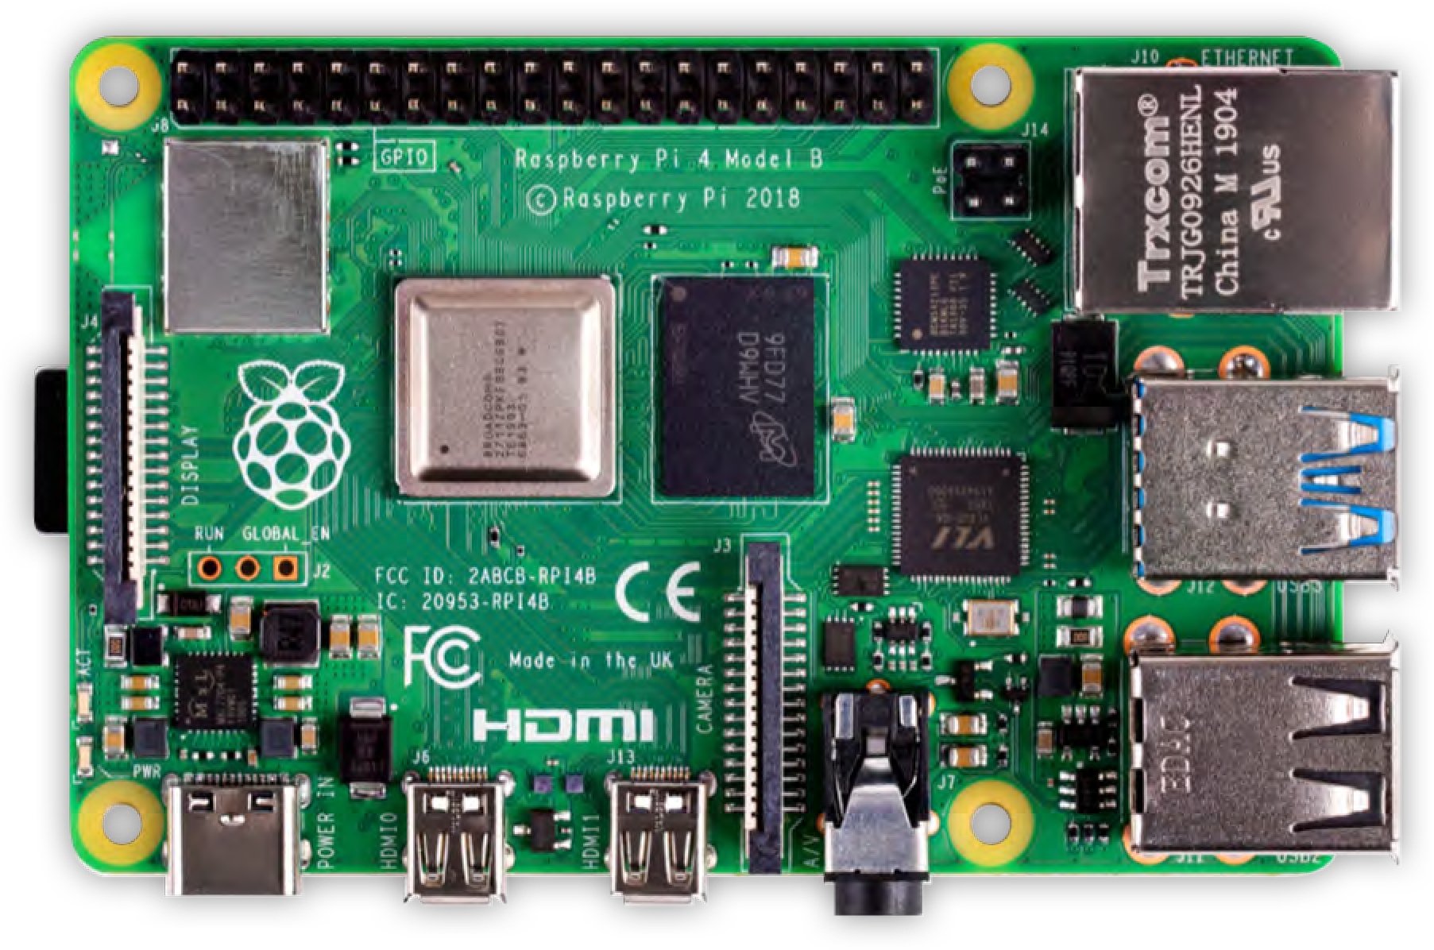
Raspberry Pi Student Projects

Slide 48
At the same time . . .
We wanted to expand our teaching methods to be more engaging.
We wanted our students:
to learn about alternative network technologies
to improve their critical thinking, creativity, communication, documentation, problem solving and troubleshooting skills

Slide 49
The Solution: Combine Both Projects into One!
Our students created & tested projects
Project materials would be used later at a summer workshops (delayed for now)
Submit written and oral proposals and final presentations to the class.
Focus on how and what they learned about applying technology & troubleshooting
Project 1: Independent Networking Home Server Project
Project 2 & 3: Groups Networking Projects Small: 2 – 4 students

Slide 50
Raspberry Pi Student Networking Projects
PiHole - blocking certain intrusive advertisements
Motion Rpi Webcam Server – webcam with motion detector
Personal Web Server – Buster & Apache
PiNAS – network attached storage
RPi NAS Server – manual configuration of Samba
RPi Cluster – needed 4 Pi’s and Switch
FreeNAS security camera
PiNet - used to setup & manage a classroom set of RPIs. *
Links will be on the web site!
21

Slide 51
Resources

Slide 52
Identify Hands-on Resources
Raspberry Pi’s have been used in K12 for programming & robotics. But not much IoT !!!!!
More activities on PiMyLifeUp for Networking (DNS, DHCP, Clusters)
Kerry Bruce, https://www.myitinstructor.com/
WASTC.org - Western Academy Support and Training Center
Many RPi projects have been published in literature and on YouTube and magazines such as MagPi (free online issues).
Jeffrey Geerling, YouTuber!

Slide 53
Resources
Sparkfun. Tutorials. https://learn.sparkfun.com/tutorials
PiMyLife Up. Latest Raspberry Pi Guides & Projects. https://pimylifeup.com/
Michigan Department of Education. (2017). Michigan Integrated Technology Competencies for Students. https://www.techplan.org/downloads/all_user_fi les/mitecs_document_fi nal_2.2.pdf
Technology Readiness Resources. MITECS: Michigan Integrated Technology Competencies for Students. https://www.techplan.org/edtech-initiatives/mitecs/
POGIL. (2021). Resources for Educators. https://pogil.org/educators/resources
Raspberry Pi Foundation. Research Projects. https://www.raspberrypi.org/research/projects.
CISCO Network Academy. Internet of Things & Analytics Courses. https://www.netacad.com/courses/iot
Raspberry Pi Tutorials - Instructions & Projects. https://tutorials-raspberrypi.com

Slide 54
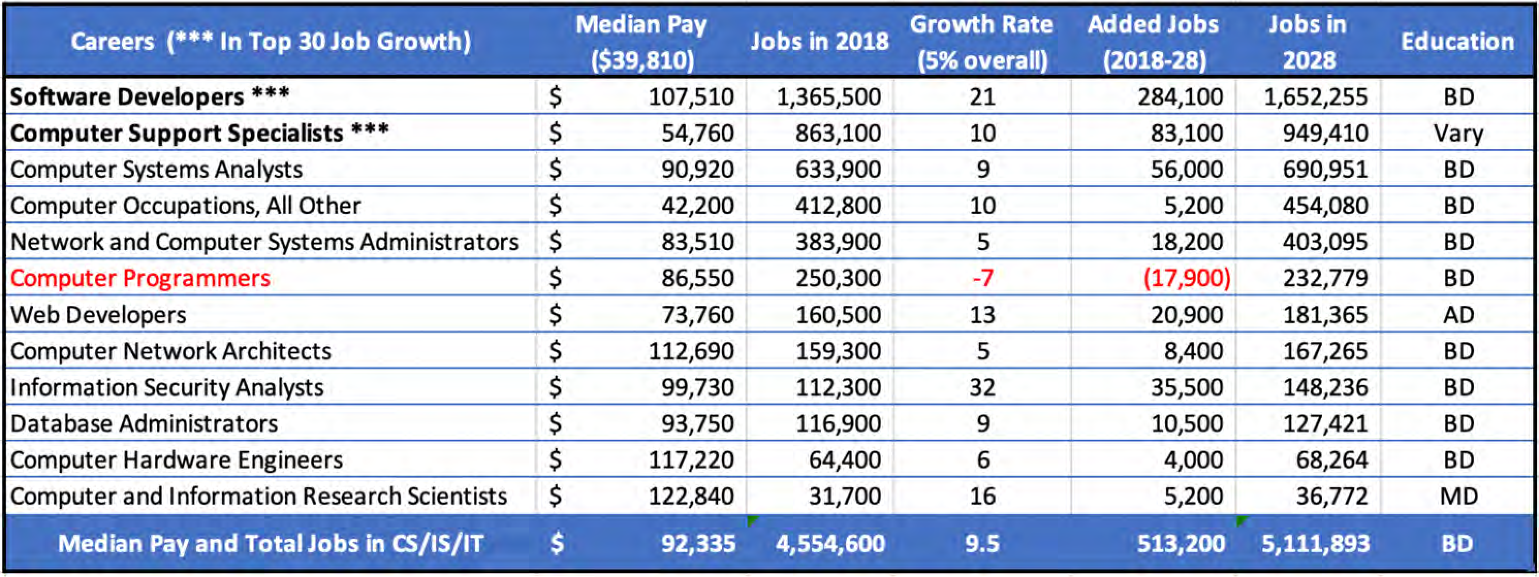
Careers in IT Related Fields
155 million employed in the US https://www.bls.gov/emp/tables/occupations-most-job-growth.htm
5
Notes:
Update data – Programming is -12%

Slide 55
Q & A
Contact
KathleenKalata@Ferris.Edu

Slide 56
Thank You for Coming!
Contact Us:
KathleenKalata@Ferris.Edu

